Slide 1
Templates to copy/paste
Definition, Term, Highlight, etc.
Example (<description>)
No way to do independence symbol. Copy/paste this (weight, color, etc. can be changed to fit, but can’t be done inline...):

Slide 2
Dappl: Decision Application
Bayesian Intelligence Pty Ltd
www.bayesian-intelligence.com
Steven Mascaro (Bayesian Intelligence)
Kevin Korb (Bayesian Intelligence & Monash University)
Xuhui Zhang (Monash University)
Dhananjay Thiruvady (Bayesian Intelligence)

Slide 3
Motivation
A decision application to guide day-to-day decisions
Applicable to a wide range of simple and complex decisions
Where uncertainty is involved
Where preferences/costs (utilities) may be defined
Examples
Dinner plans
Buying a washing machine
Buying a car
Conference location
Conduct medical tests
The nerve test

Slide 4
Buying a Car
New
Reliability (10)
Independence (10)
Convenience (50)
Longevity (10)
Finance (-150)
Rego (-1)
Insurance (-1)
Fuel (-1)
Health (-2)
Environment (-100)
Used
Reliability (0)
Independence (10)
Convenience (40)
Longevity (-10)
Purchase cost (-50)
Rego (-1)
Insurance (-1)
Fuel (-1)
Health (-2)
Environment (-80)

Slide 5
Conference Location
Orlando
Conference theme (10)
Collaboration potential (8)
Conference reputation (5)
Travel time (-2)
Time zone (-1)
Previously visited (0)
Culture & history (1)
Short holiday after (1)
Barcelona
Conference theme (5)
Collaboration potential (2)
Conference reputation (10)
Travel time (-1)
Time zone (-2)
Previously visited (-1)
Culture & history (3)
Short holiday after (2)

Slide 6
Current Tool
Case study: breast cancer diagnostic support
Determine whether to conduct the triple test
Physical examination
Imaging tests: e.g. MRI
Biopsy: investigate a sample
Underlying Bayesian network, a pre-defined model
Given symptoms, carry out test?
Costs
Effort/Stress
Determine utilities
Pre-defined scenarios
Can be user-defined

Slide 7
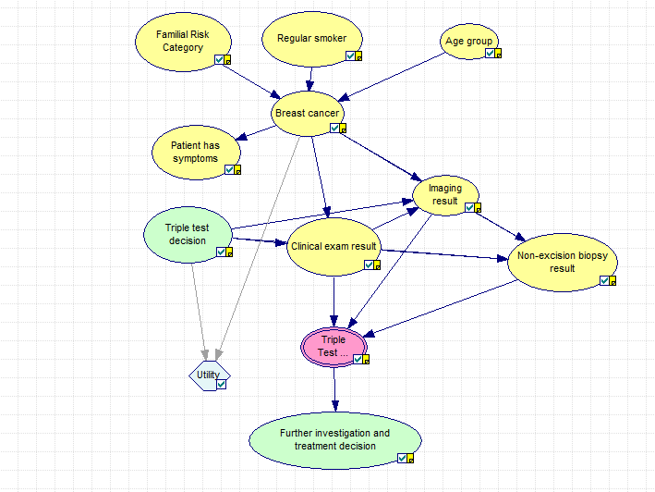
Breast Cancer Diagnostic Support (BN)

Slide 8
Breast Cancer Diagnostic Support (tool)

Slide 9
Conclusions
Dappl: a tool to assist with day-to-day decisions
Simple, complex or specialised decisions
Web-based tool
Demonstrated on breast cancer diagnosis
Known factors that influence and are influenced
Scenarios to assist user with preferences
Decision about whether to do the triple test or not
Future possibilities
A phone app
Extend to highly specialised (custom) examples
E.g. conference location
Incorporate complex BNs, including learning structure

